Slide 1
Sequence Diagrams (UML)
Health Application (Team 4)

Slide 2
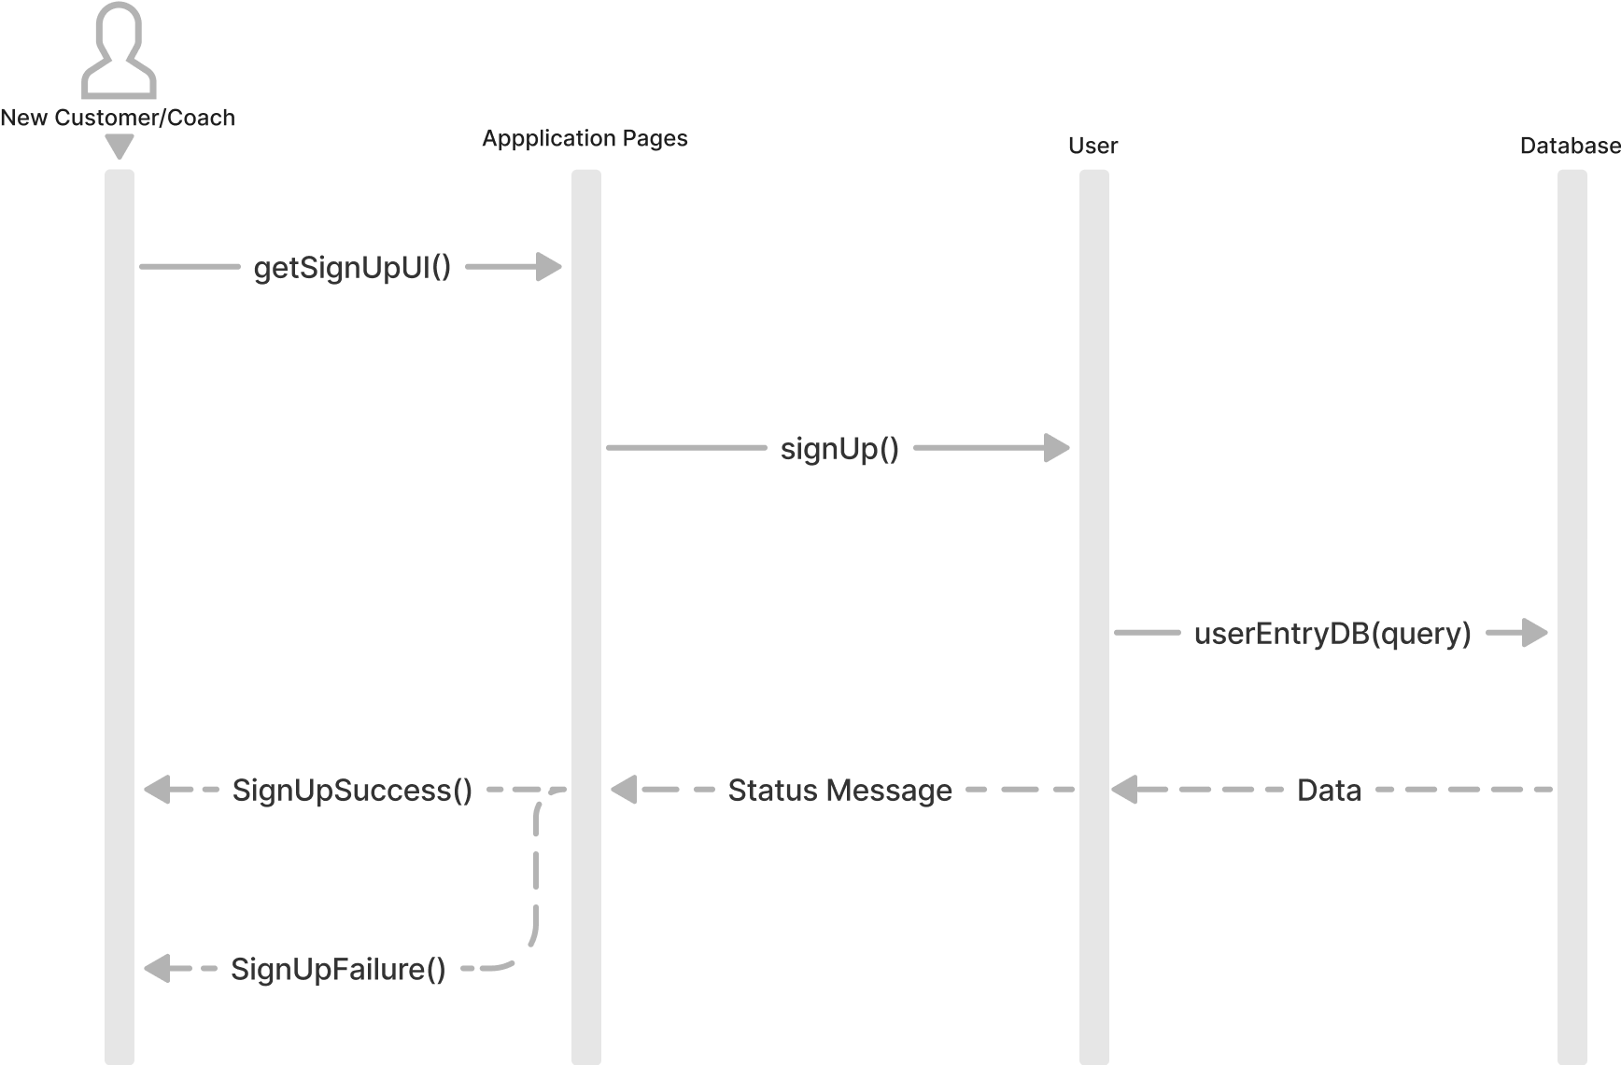
1.01(Authenticate Account) Sign Up - Customer/Coach
A new user (Customer/Coach) tries to sign up to the application

Slide 3
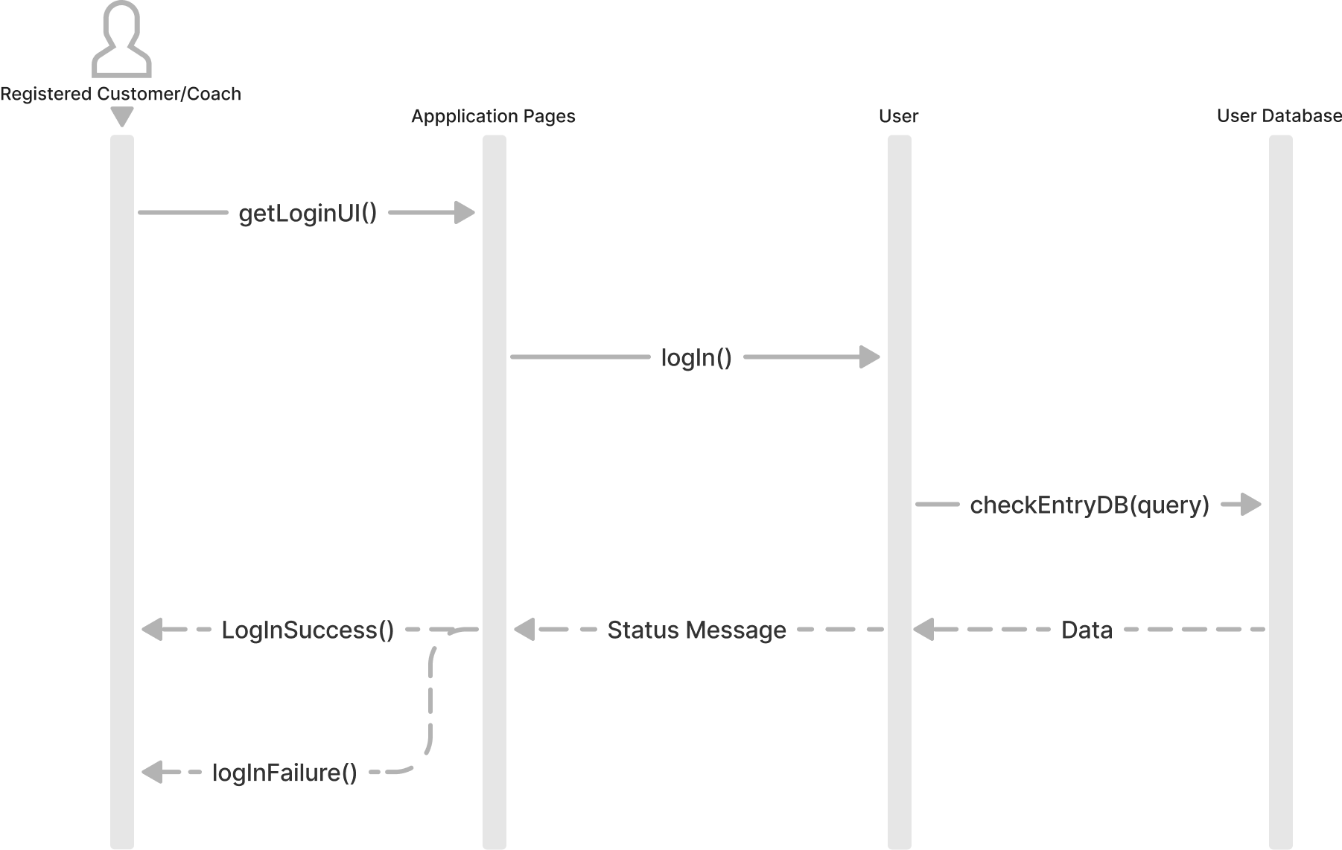
1.01(Authenticate Account) Login - Customer/Coach
A registered user (Customer/Coach) tries to login to the application

Slide 4
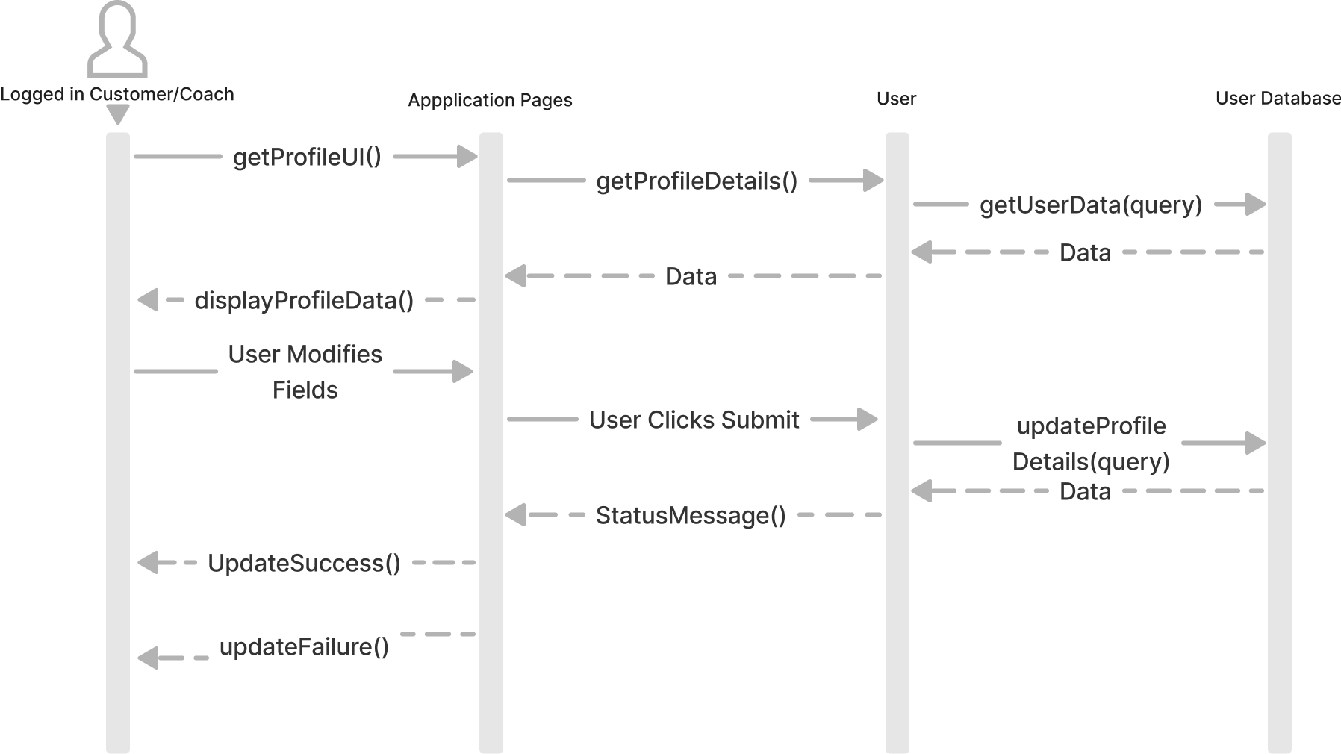
1.01(Account Overview) Login - Customer/Coach
A logged in user (Customer/Coach) tries to view / update their profile information

